Slide 1
Guide to Creating a Poster Presentation
All Wales Special Interest Group / Special Oral Healthcare
www.sigwales.org

Slide 2
What is an academic poster?
An academic poster is a visual way of communicating information
It needs to grab attention and convey a message in a compelling way
It should include a mixture of text and graphics
They should be referenced appropriately
They should be designed so others can read and understand the information quickly

Slide 3
What you should know before you start …
The category you are entering e.g. Dentist / DCP
That your topic meets the brief of the poster competition (you may be asked to submit an abstract for approval before you start your poster)
The size of the poster required (A0)
Whether they want the posters presented landscape / portrait – SIG 2024 PORTRAIT
Any word limit

Slide 4
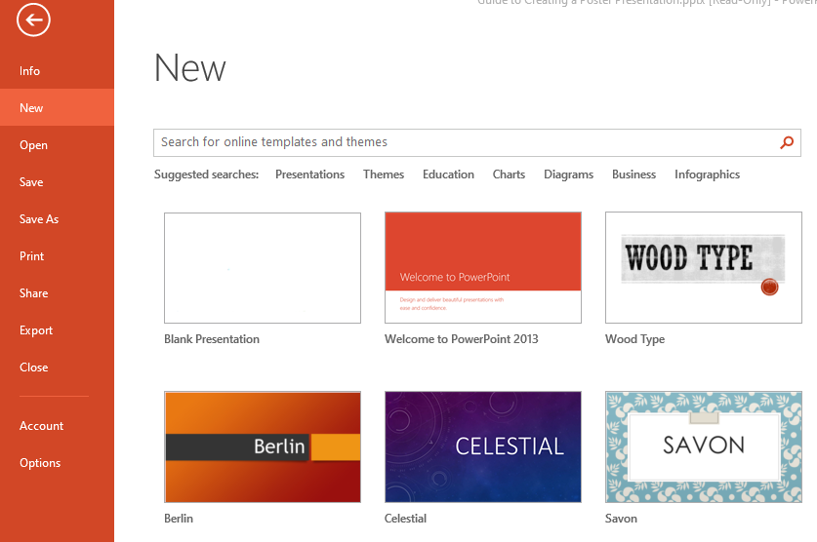
PowerPoint
Microsoft PowerPoint is a useful tool to use to create a poster
Create a ‘blank presentation’

Slide 5
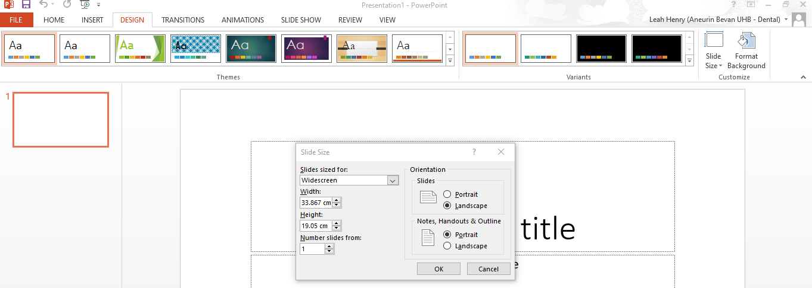
To unsure your poster is the correct size and orientation, select the ‘Design’ tab then ‘Slide Size’
Use the ‘Custom Slide Size’ option to format the size and orientation:
A0 poster in portrait – 1189mm x 841mm

Slide 6
Design your poster by adding text boxes and image boxes
There are features within PowerPoint that help to ensure that the layout is consistent and content aligned:
Ruler – horizontal and vertical
Guides – moveable dotted lines that appear on the screen but do not print
Found in the ‘View’ tab
You may be asked by the printing service to save as a PDF prior to printing

Slide 7
Formatting your poster
Content should be clearly and logically laid out using headings and subheadings
Examples of subheadings:
Introduction
Method
Results
Discussion
Conclusions
References

Slide 8
Layout tips
Have a clear point of entry for the reader
Have a logical structure – your poster should read from top left to bottom right, like reading a page
Consider using arrows / numbers to guide the reader

Slide 9
Design Tips
Avoid over-complicating your design – don’t use a lot of different fonts and colours
Avoid overcrowding your poster – use margins to separate information and images – white space is good space!
Maintain a good contrast between the background and the text e.g. light colour background and dark text
To prevent cropping when printing, have a 2.5cm margin around the edge of the poster

Slide 10
Text Tips
Recommended fonts:
Arial
Verdana
Garamond
Palatino
For consistency use the same font throughout
Use bold, italic, UPPER CASE and bullets for emphasis
Use line spacing to help make test fit in a text box / space you want it to
Make all headings the same size and use the same font size throughout
Normal text minimum:
Body text – 18 point
Headings and subheadings – 22 point
Main title – 46 point

Slide 11
Referencing
It is important to reference all material as you would for any academic writing
If a referencing style hasn’t been specified by the organisers, Vancouver style referencing is best for a poster presentation
A useful guide to Vancouver style referencing can be found at: www.imperial.ac.uk/media/imperial-college/administration-and-support-services/library/public/Vancouver.pdf

Slide 12
The Day of the Presentation
Take something to stick your poster up with (this isn’t always provided)
Sticky velco works well
Safety pins
Be prepared to stay with your poster during conference break times to answer questions

Slide 13
Finally …
Your employing trust will likely have a media service that can offer support with poster design and printing
Get feedback from colleagues and friends before submitting

